Slide 1

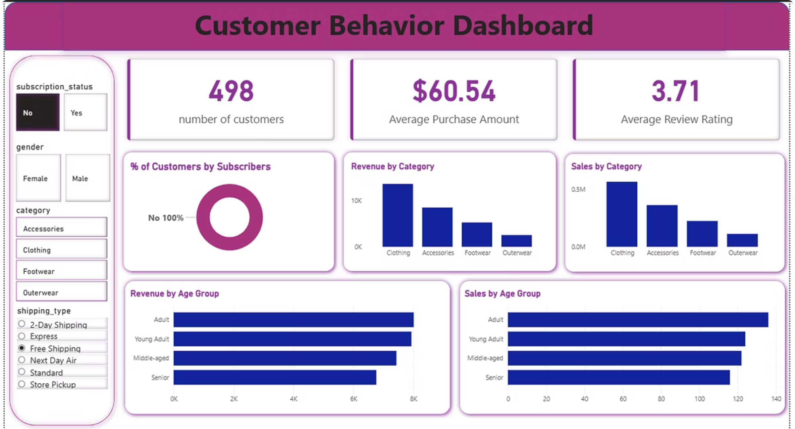
Customer Shopping Behavior Analysis
Uncovering insights from 3,900 purchases to guide strategic business decisions through data-driven analysis of spending patterns, customer segments, and product preferences.

Slide 2
Dataset Overview
3,900
18
50
25
Total Purchases
Data Features
Locations
Product Types
Transactions analyzed across various product categories
Comprehensive attributes tracking customer behavior
Geographic diversity in customer base
Diverse inventory across multiple categories
Key features include customer demographics, purchase details, shopping behavior metrics, and subscription status. Only 37 missing values in Review Rating column.

Slide 3

Data Preparation Journey
01
Data Loading & Exploration
Imported dataset using pandas, examined structure with df.info() and summary statistics
02
Missing Data Handling
Imputed 37 missing Review Rating values using median rating per product category
03
Feature Engineering
Created age_group bins and purchase_frequency_days columns for deeper insights
04
Database Integration
Connected to PostgreSQL and loaded cleaned data for SQL analysis

Slide 4

Revenue Insights
$233K
Total revenue analyzed across all customer segments
Gender Revenue Split
Male customers: $157,890 (68% of total)
Female customers: $75,191 (32% of total)
Subscription Impact
Non-subscribers: $170,436 total revenue
Subscribers: $62,645 total revenue
Average spend similar: $59.87 vs $59.49

Slide 5
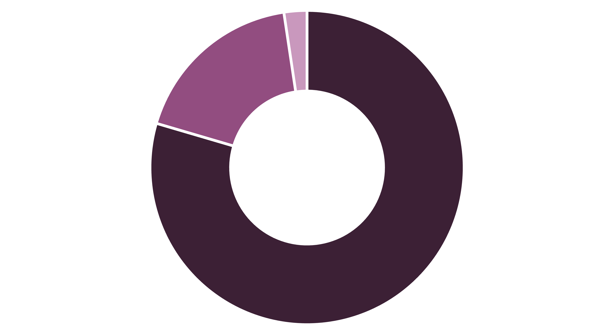
Customer Segmentation
Loyal
Returning
New
Loyal customers dominate at 80% of the base, with 958 repeat buyers (>5 purchases) showing subscription interest. Focus on converting Returning customers to Loyal status.

Slide 6
Product Performance Leaders
1
2
3
Gloves
Sandals
Boots
Rating: 3.86/5.0
Rating: 3.84/5.0
Rating: 3.82/5.0
Highest-rated product across all categories
Top footwear choice with 160 total orders
Strong performer in footwear category
4
5
Hat
Skirt
Rating: 3.80/5.0
Rating: 3.78/5.0
50% discount rate - highest dependency
Consistent top performer in clothing

Slide 7
Category Champions
Accessories
Clothing
Jewelry - 171 orders
Blouse - 171 orders
Sunglasses - 161 orders
Pants - 171 orders
Belt - 161 orders
Shirt - 169 orders
Footwear
Outerwear
Sandals - 160 orders
Jacket - 163 orders
Shoes - 150 orders
Coat - 161 orders
Sneakers - 145 orders

Slide 8
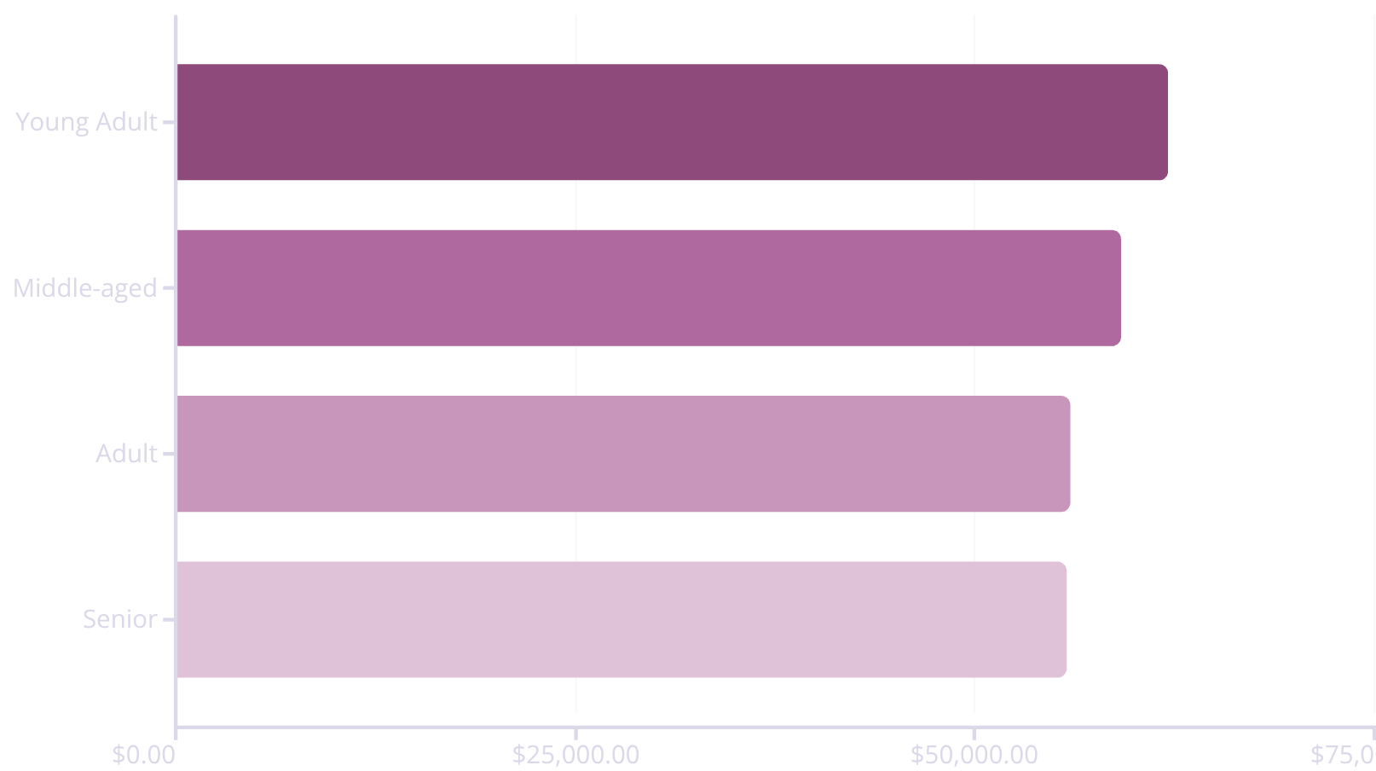
Age Group Revenue Distribution
Key Insights
Young Adults lead revenue generation at $62K, followed closely by Middle-aged customers at $59K. Revenue distribution is relatively balanced across age groups.
Shipping Preference: Express shipping users spend $2 more on average ($60.48 vs $58.46) than Standard shipping customers.

Slide 9



Discount Strategy Analysis
43%
839
50%
Discount Usage
High-Value Discount Users
Hat Discount Rate
1,677 of 3,900 purchases used discounts
Customers who spent above average despite discounts
Highest discount dependency among all products
Top 5 discount-dependent products: Hat (50%), Sneakers (49.66%), Coat (49.07%), Sweater (48.17%), Pants (47.37%). Balance promotional strategy with margin control.

Slide 10

Strategic Recommendations
Boost Subscriptions
Loyalty Programs
Review Discount Policy
Promote exclusive benefits to convert 2,847 non-subscribers. Target repeat buyers with >5 purchases.
Reward repeat buyers to move 701 Returning customers into Loyal segment.
Balance 43% discount usage with margin control. Focus on high-value discount users.
Product Positioning
Targeted Marketing
Highlight top-rated products (Gloves 3.86, Sandals 3.84) and category champions in campaigns.
Focus on Young Adults ($62K revenue) and express-shipping users ($60.48 avg spend).

